Slide 1
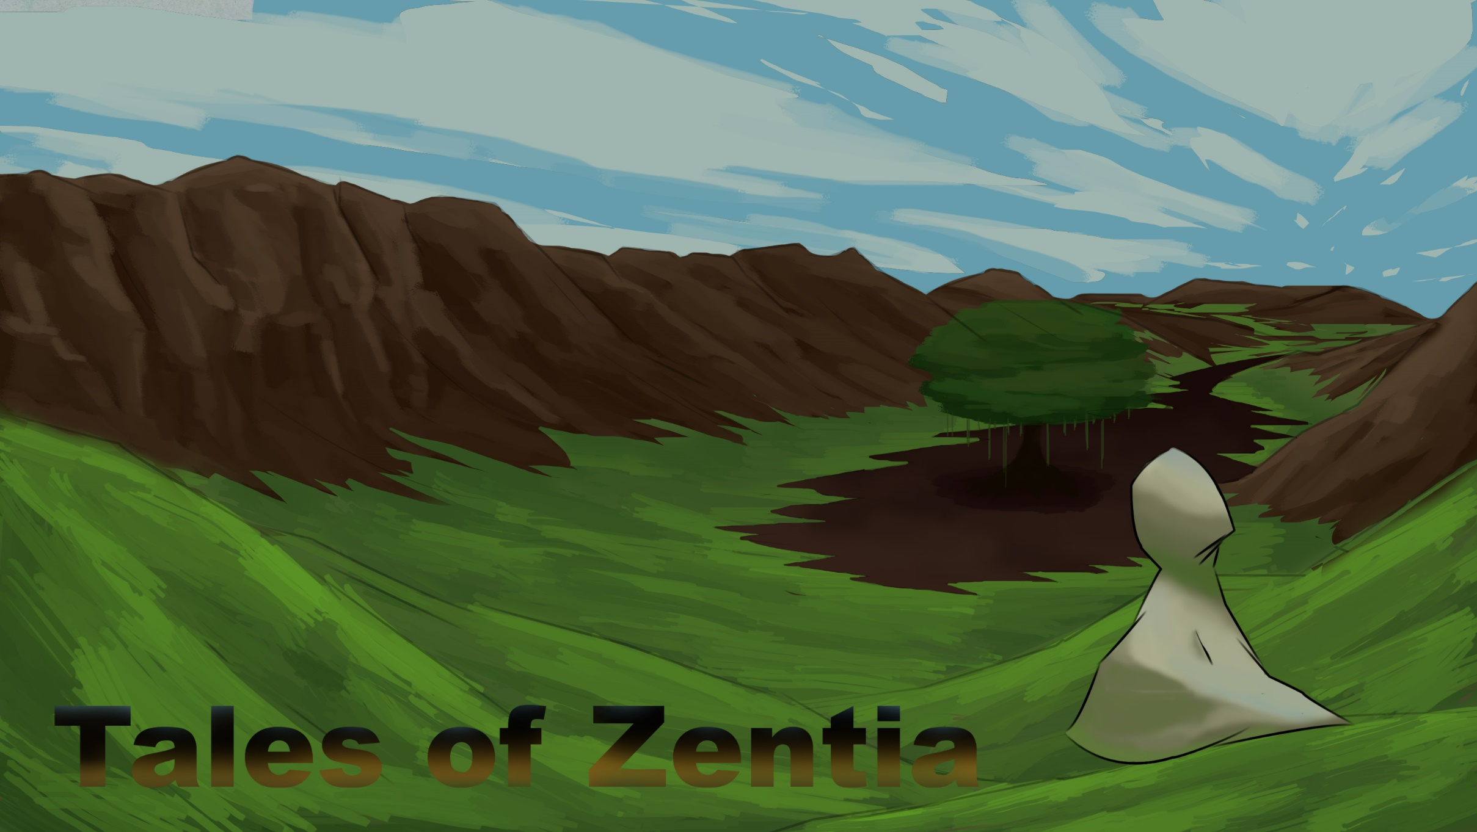
PLATFORMER GAME

Slide 2
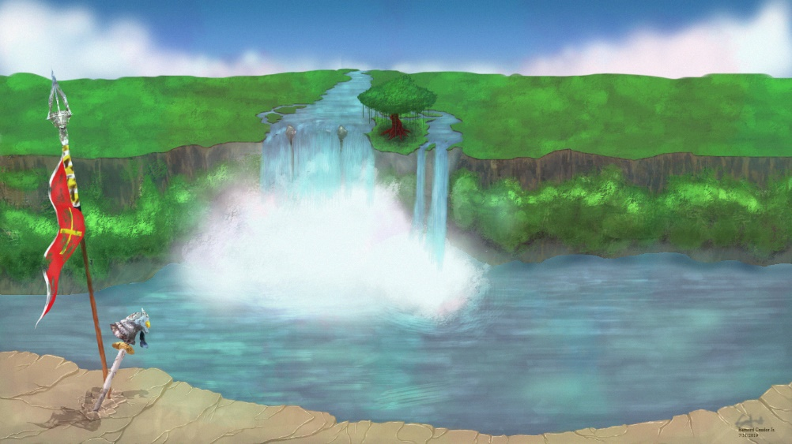
I. Project Description

Slide 3
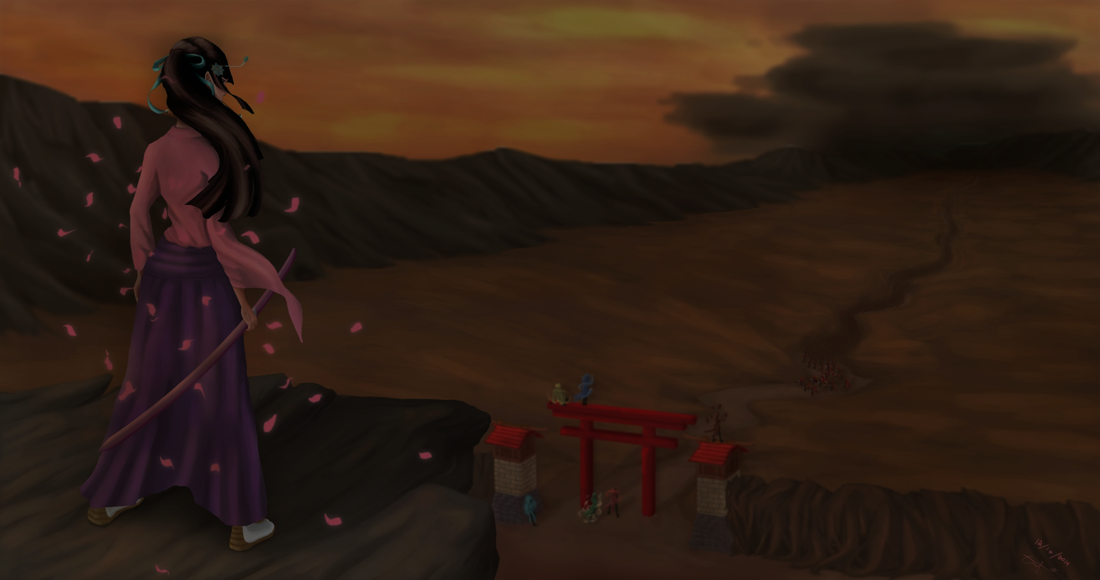
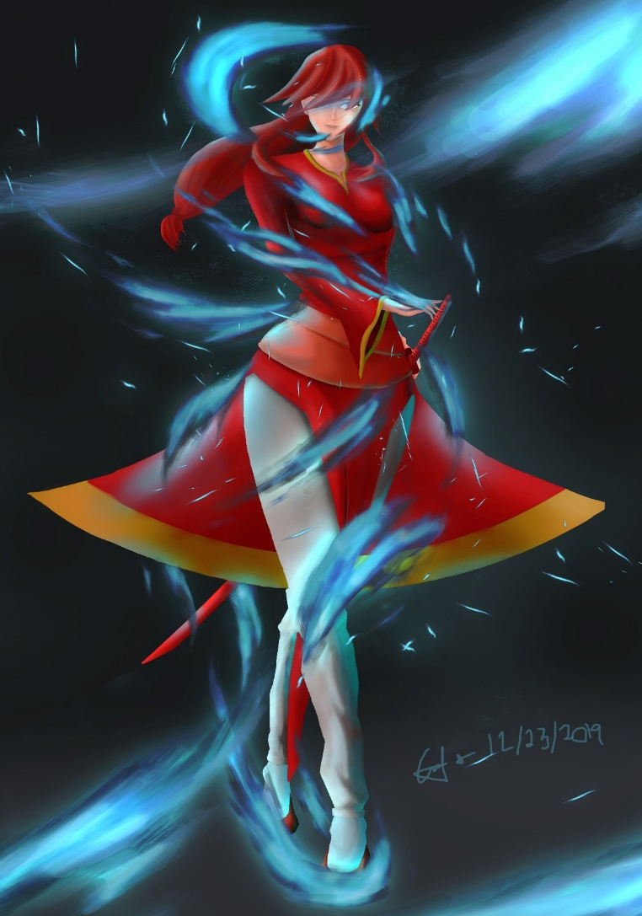
Story and concept based:
Tales of Zentia, a text based game that was created last two years ago by our member Bernard Candor. The story talks about a fictional land called Zentia where all creatures live harmony but calamity struck and Izana which is one of the supporting character begins her quest in protecting Zentia.

Slide 4
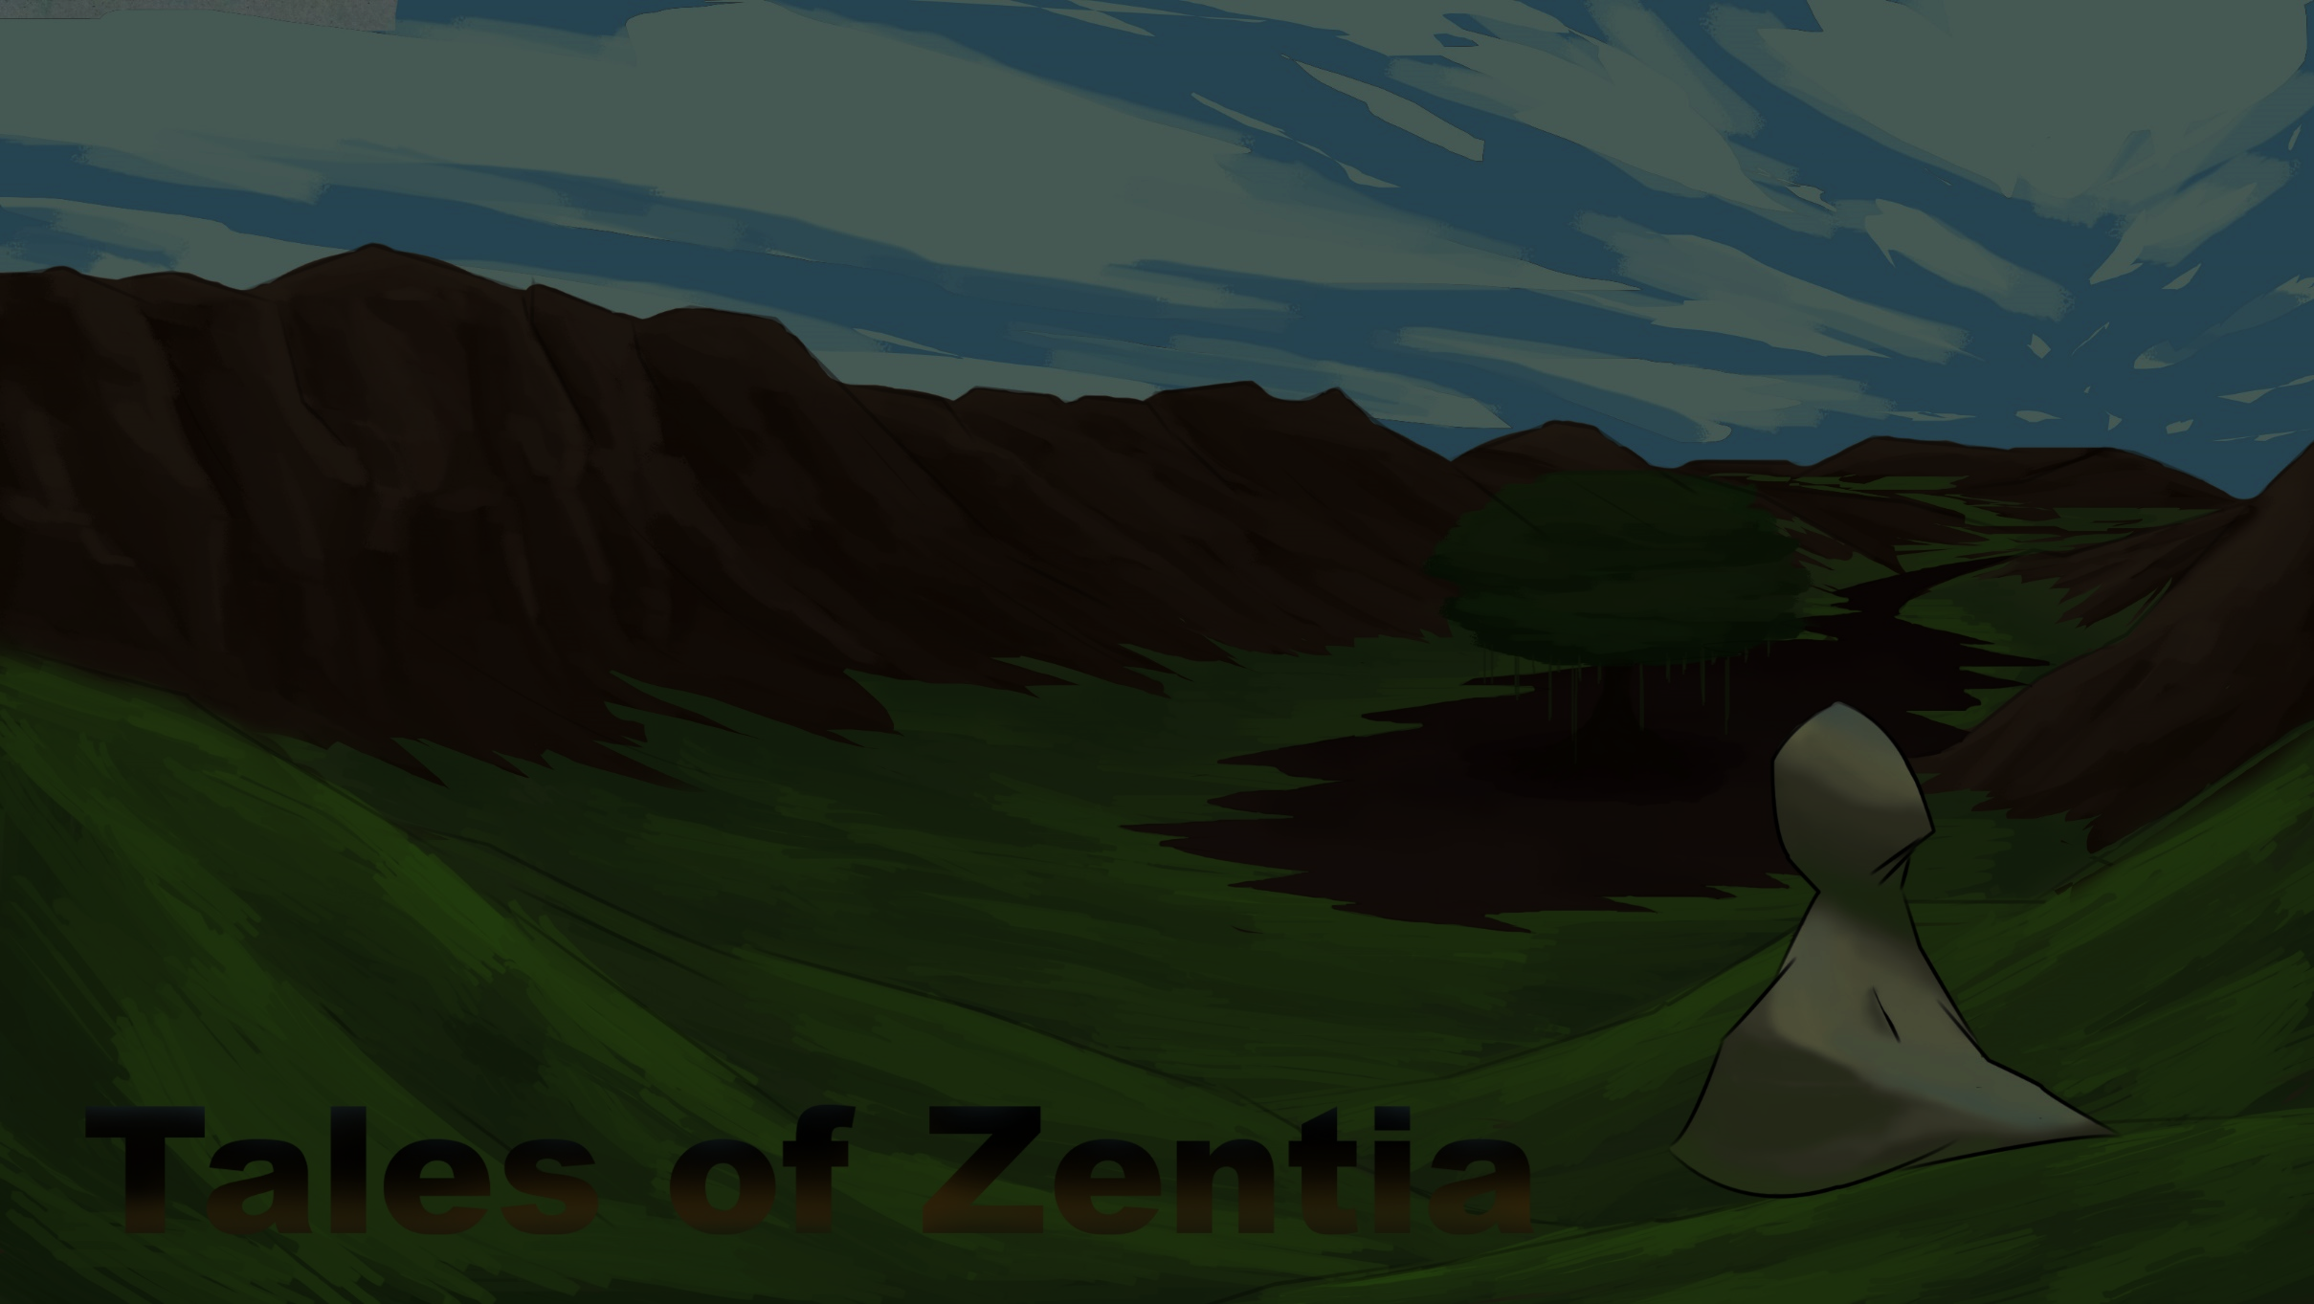
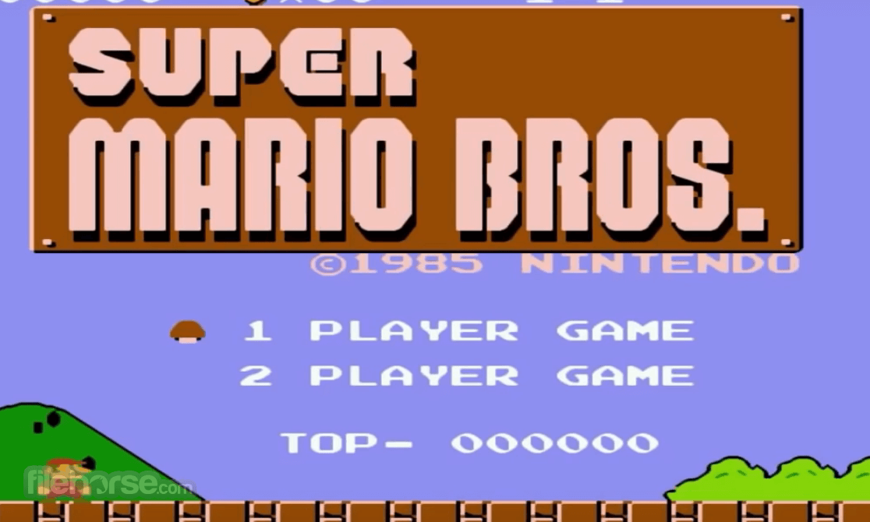
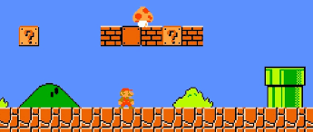
Algorithm and Gameplay based:
Super Mario is a Japanese platform video game series and media franchise created by Nintendo and featuring their mascot, Mario. As in platform video games, the player runs and jumps across platforms and atop enemies in themed levels. Which includes simple plots like rescuing the princess from the primary antagonist.

Slide 5
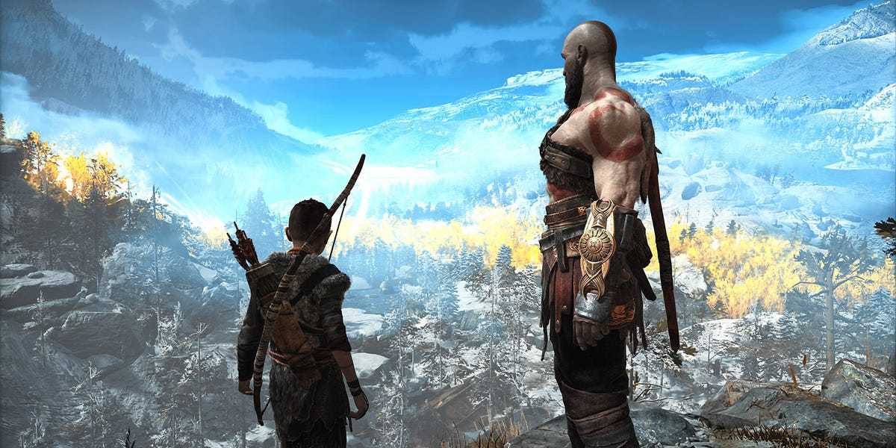
tsadasd
RPG Game, Role Playing Game. The player will take the role of the character in a fictional settings.
In our game player is have the role Izana which is the supporting character for the main protagonists.

Slide 6
II. Game Description
Izana, a supporting character for the main protagonist find herself summoned to a specific location where the 7 Arnament of Sins members is destined to meet. Izana need to make her way in the Dead Zone where dead people manifested into gruesome creatures and no one dare to enter the place. The users goal is get to Izana in the yellow mark to teleport her to another location until she gets out of the place.

Slide 7
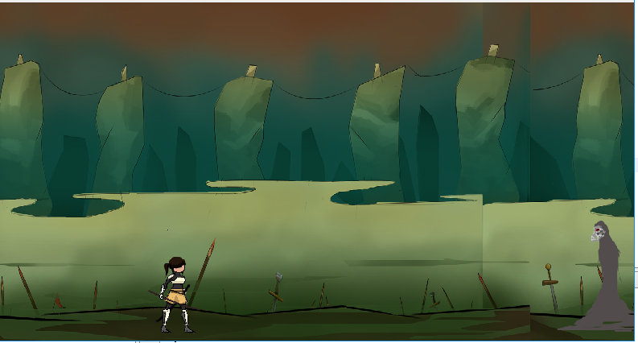
Enemy
User

Slide 8
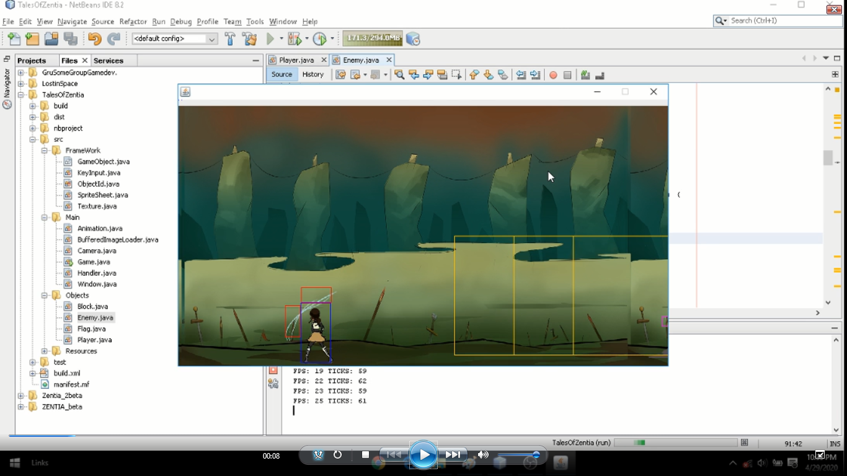
Note ! The RED box indicate your hitbox while the BLUE box is your hurtbox
The YELLOW box here indicates the eyes or view of the enemy

Slide 9
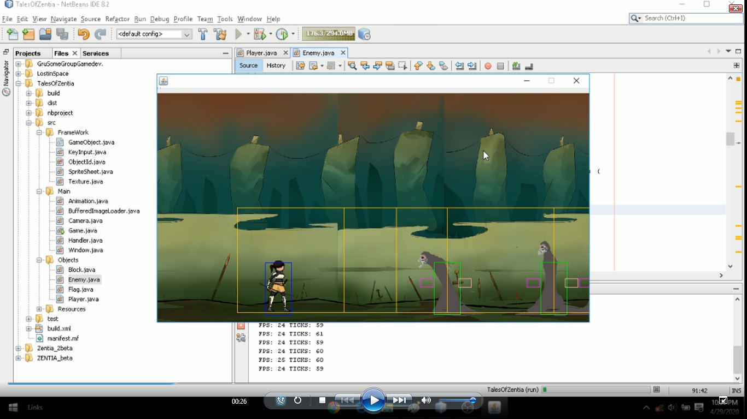
Note ! When your hurtbox intersects or get inside the box the enemy will run towards you
The PINK and MAGENTA box is the attack range of the enemy

Slide 10
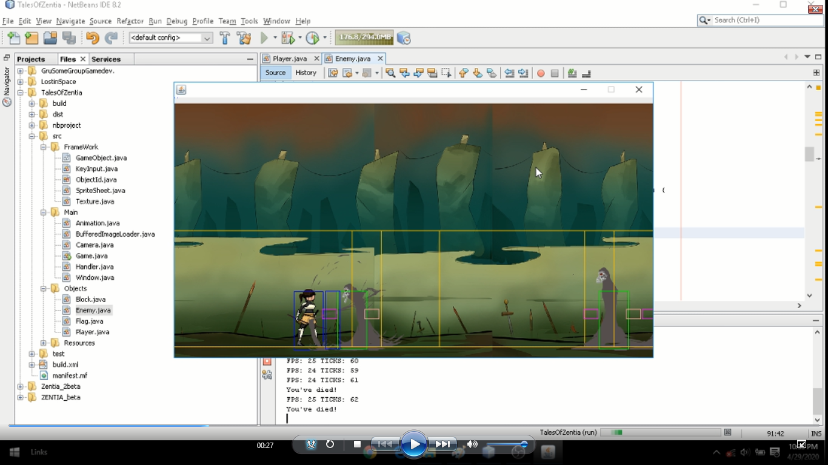
The Boxes that you see here will not be present when you play the game as this boxes is only used for the development of the game.

Slide 11
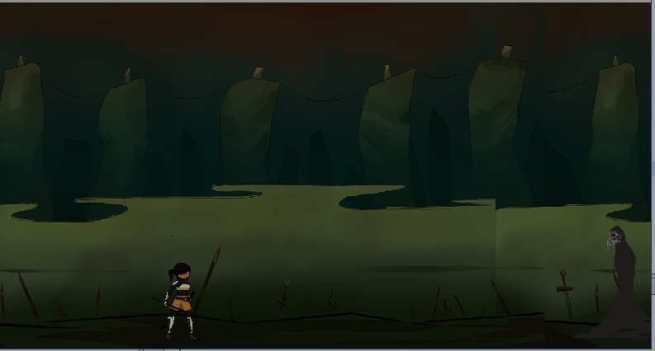
III. Game Play
No Menu screen jumps to starting game
To jump is SPACE, and for ATTACKING is K
ESC button causes the game to exit.
Controls is A for move LEFT, while D for move RIGHT

Slide 12
GOAL
Reach the far end of the map and reach the yellow marker to advance to the next level. It consists of 3 levels you can kill the enemy with one strike and they can also kill you with one strike so becareful.

Slide 13
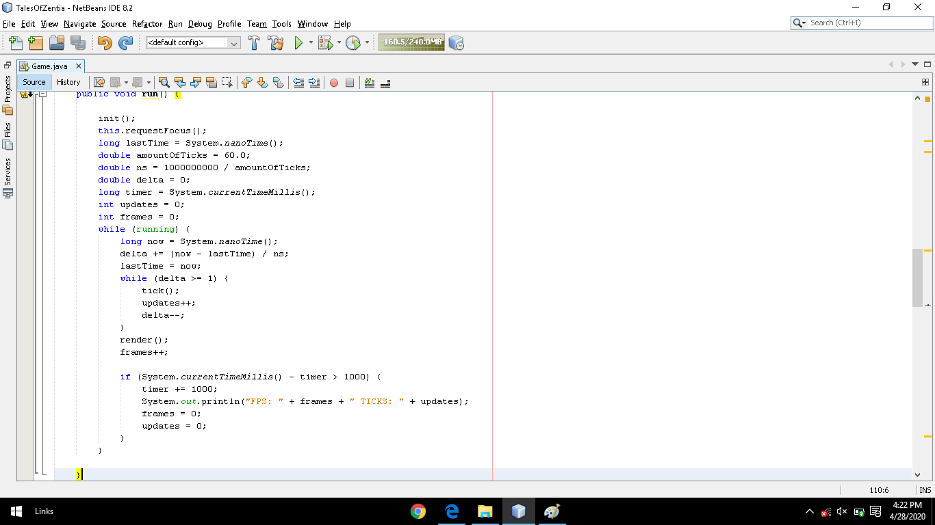
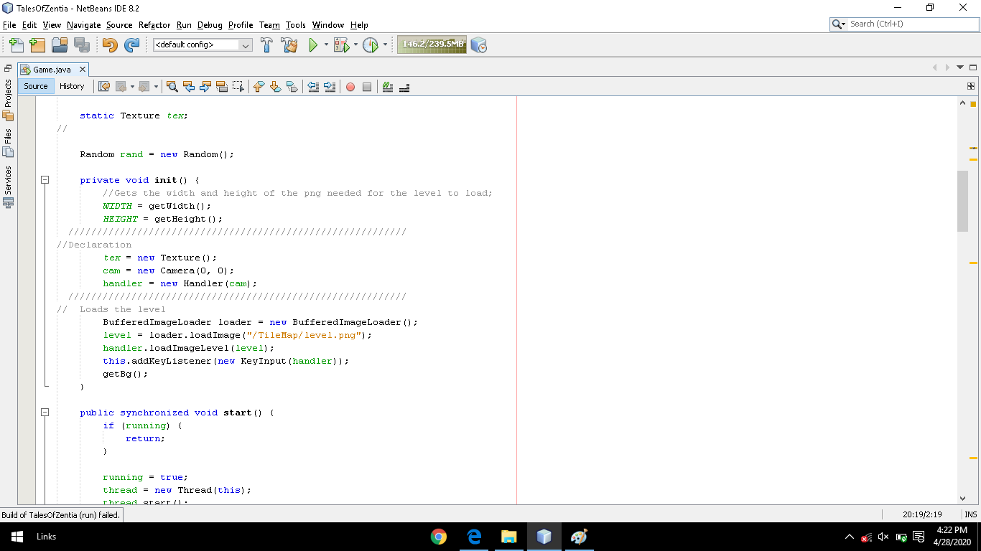
IV. Significant Codes
Game

Slide 14
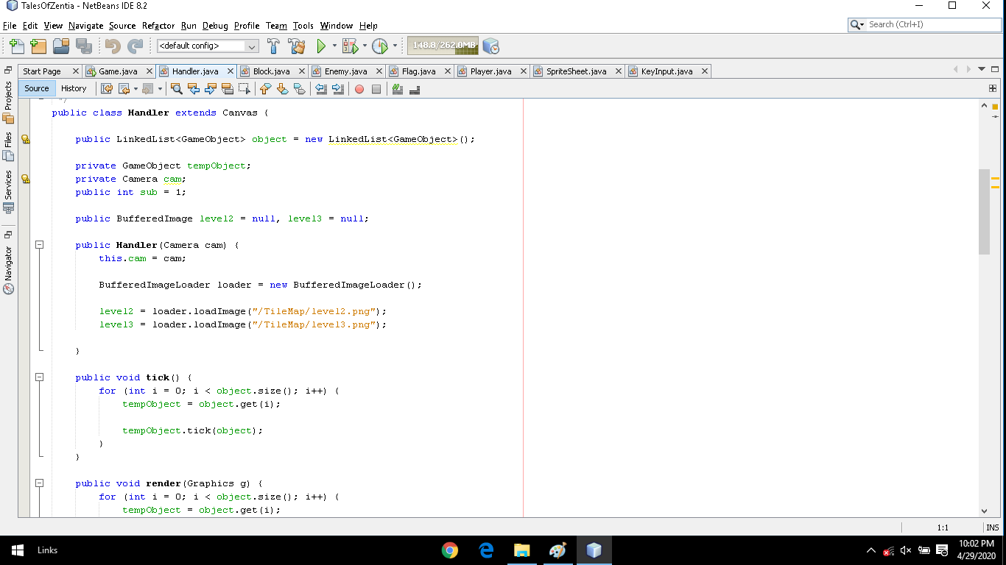
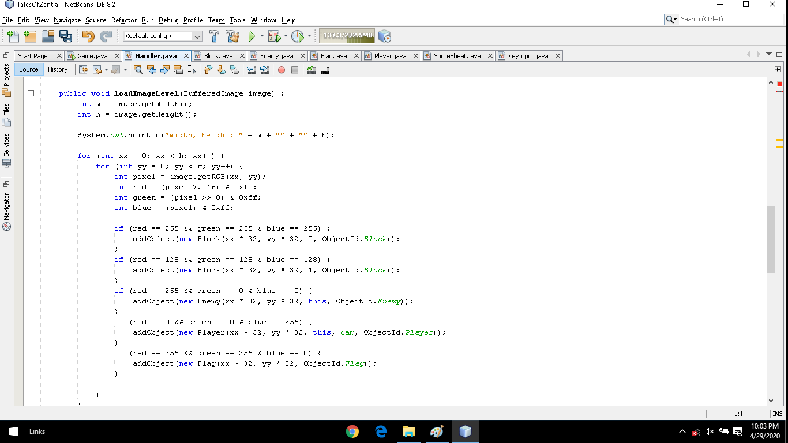
Handler

Slide 15
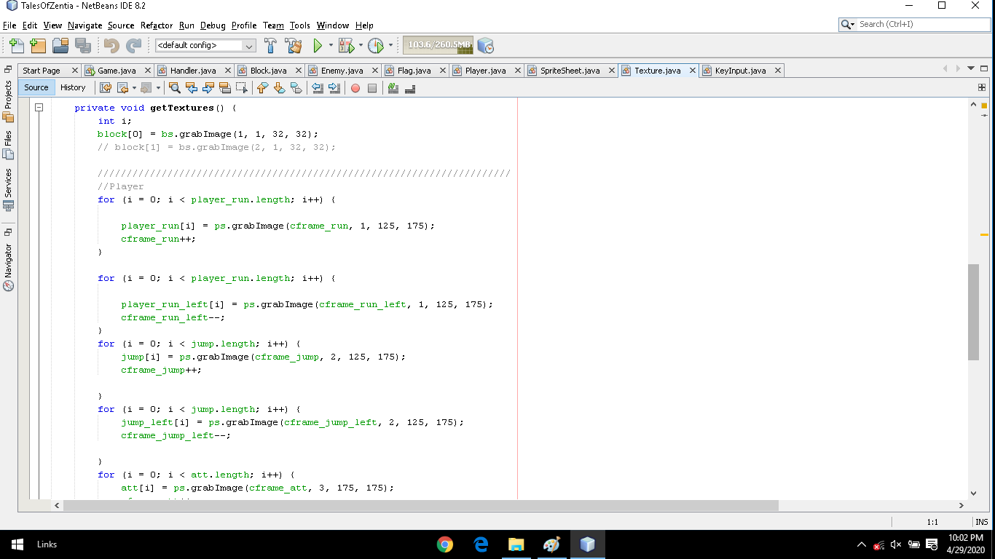
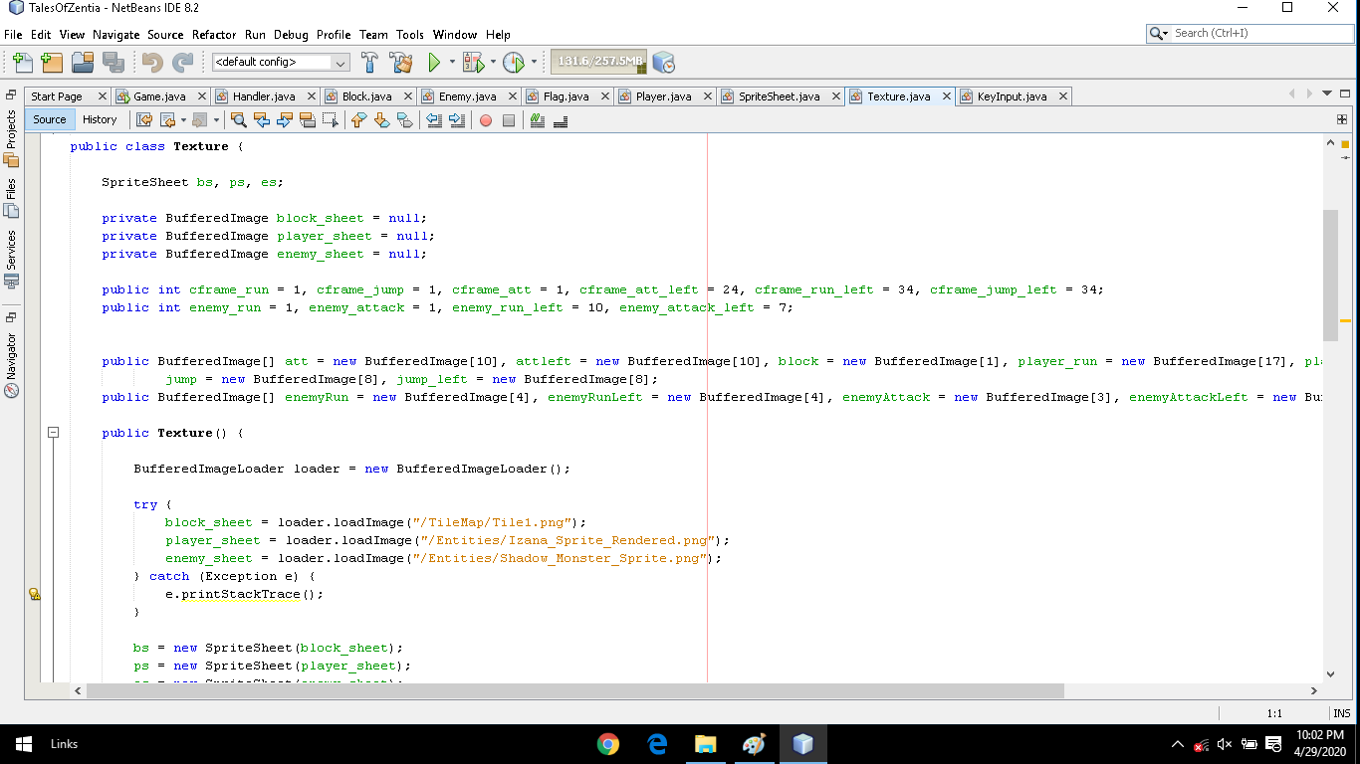
Texture

Slide 16
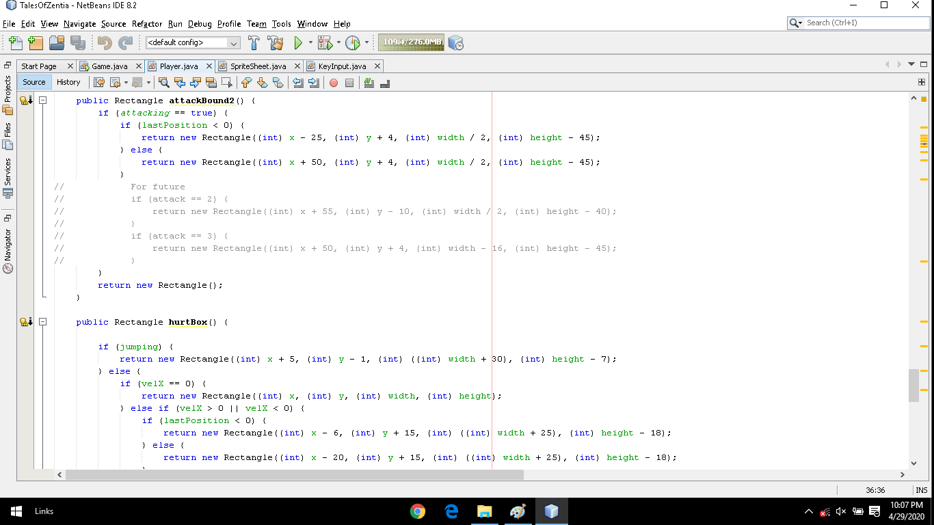
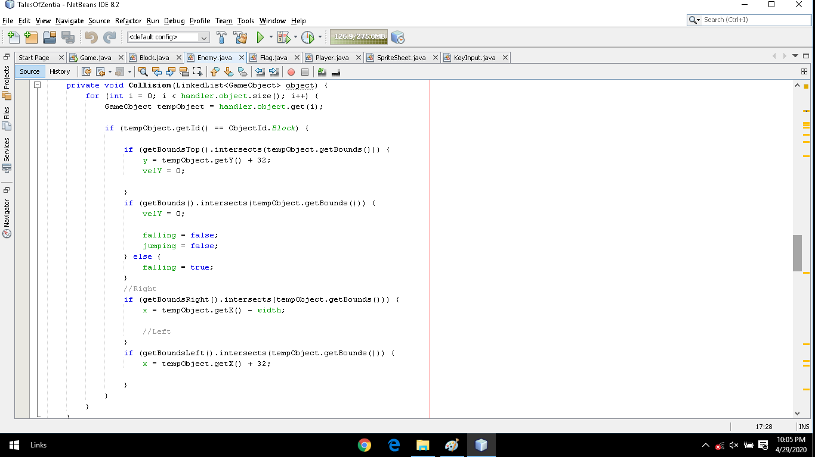
Player

Slide 17
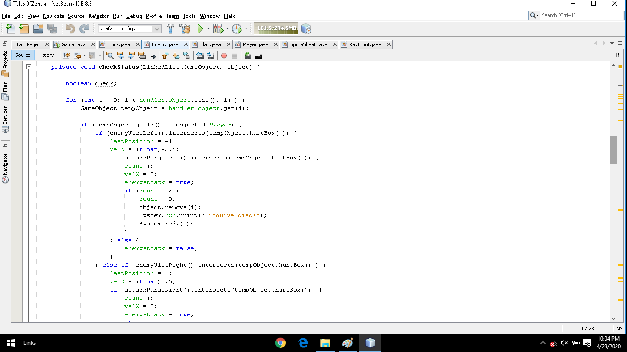
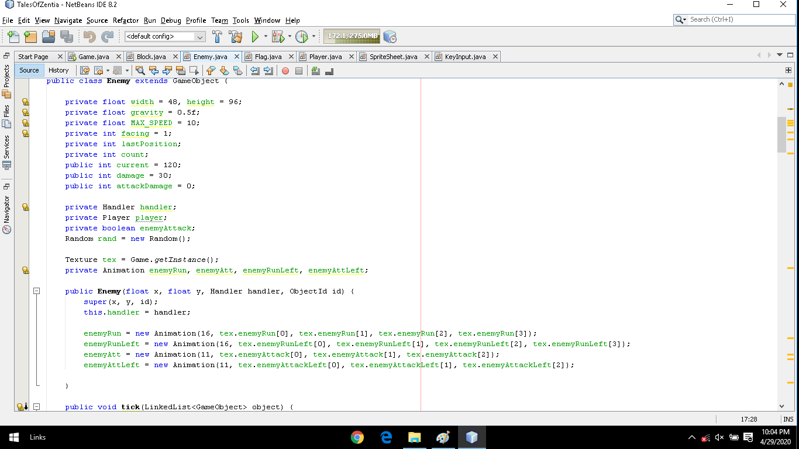
Enemy

Slide 18
V. Source Code
https://www.youtube.com/watch?v=DXT11ZbB2Mk&list=PLWms45O3n--54U-22GDqKMRGlXROOZtMx

Slide 19
GitHub Link
https://github.com/MrCat26/GameProjectBy5S-CC3-1G-Tales-Of-Zentia.git

